Slide 1
The New Worthing High School
Notes And Photos From The Field Trip

Slide 2
School Ideas
T.V.’s That Say The Menu For Each Department Of Food.
Bigger Library.
Use Of A lot Of Natural Light.
Teachers that bond with students.
A lot Of Open Space.
Do Work On Laptops.

Slide 3
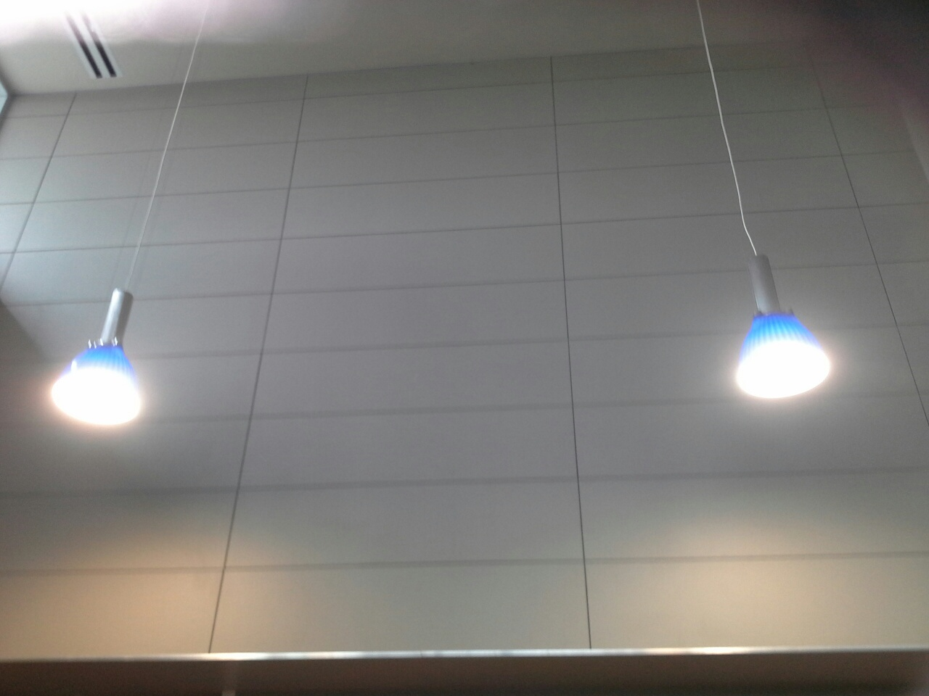

Slide 4
More School Ideas
The Use Of Fins = A Form Of Shade Above All Windows.
The Use Of Letting School Teachers Decorate The School With Educational Words Or Notes.
Solar Panels For Parts Of School.
Be Organized.
Bigger Hallways.

Slide 5
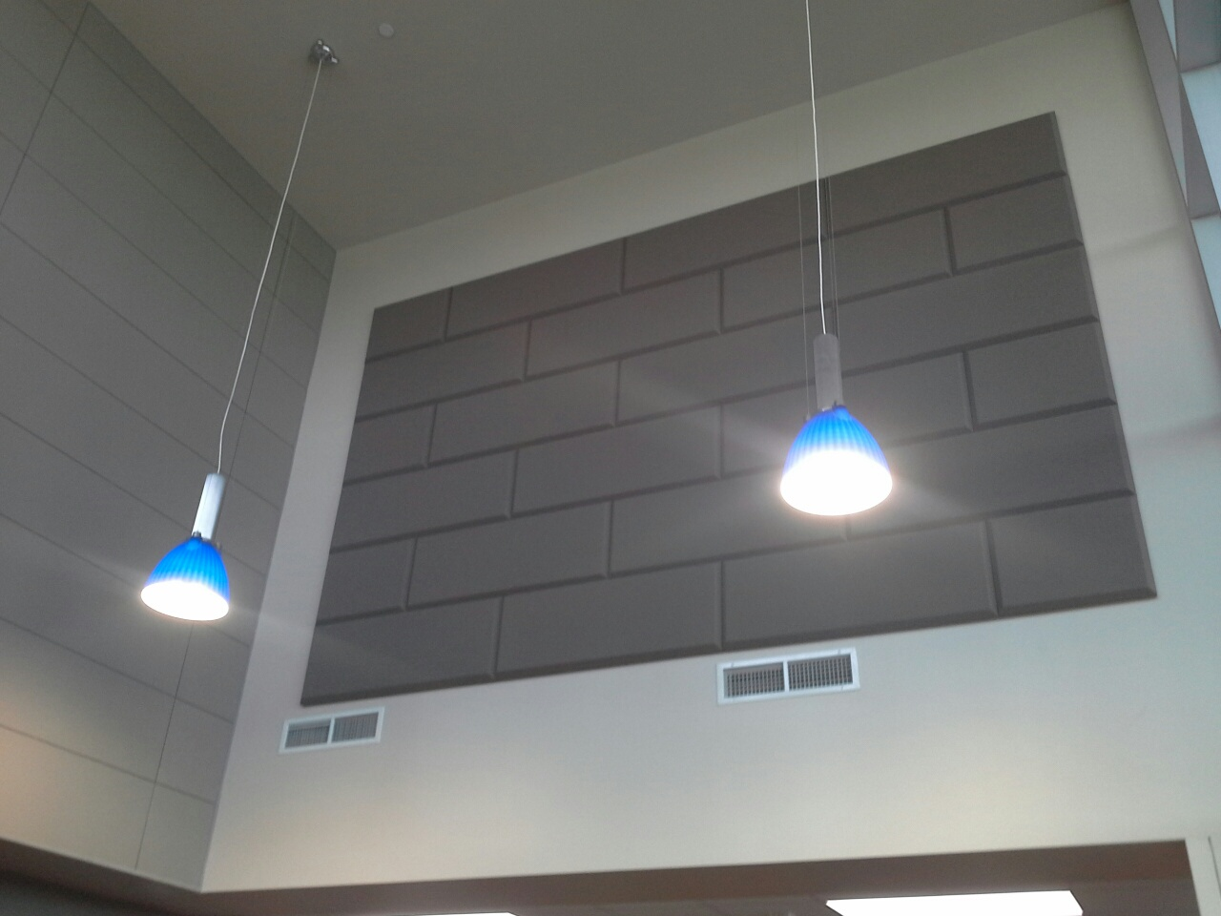

Slide 6
More School Ideas
A List Of Our Business Partners List
T.V.’s That Tell You The Agenda For The Day.
Have A School Motto.
Have A College Like Time Schedule To Get Ready For College Time.
Have A Unique Style.
Have A Museum For Our School History.

Slide 7
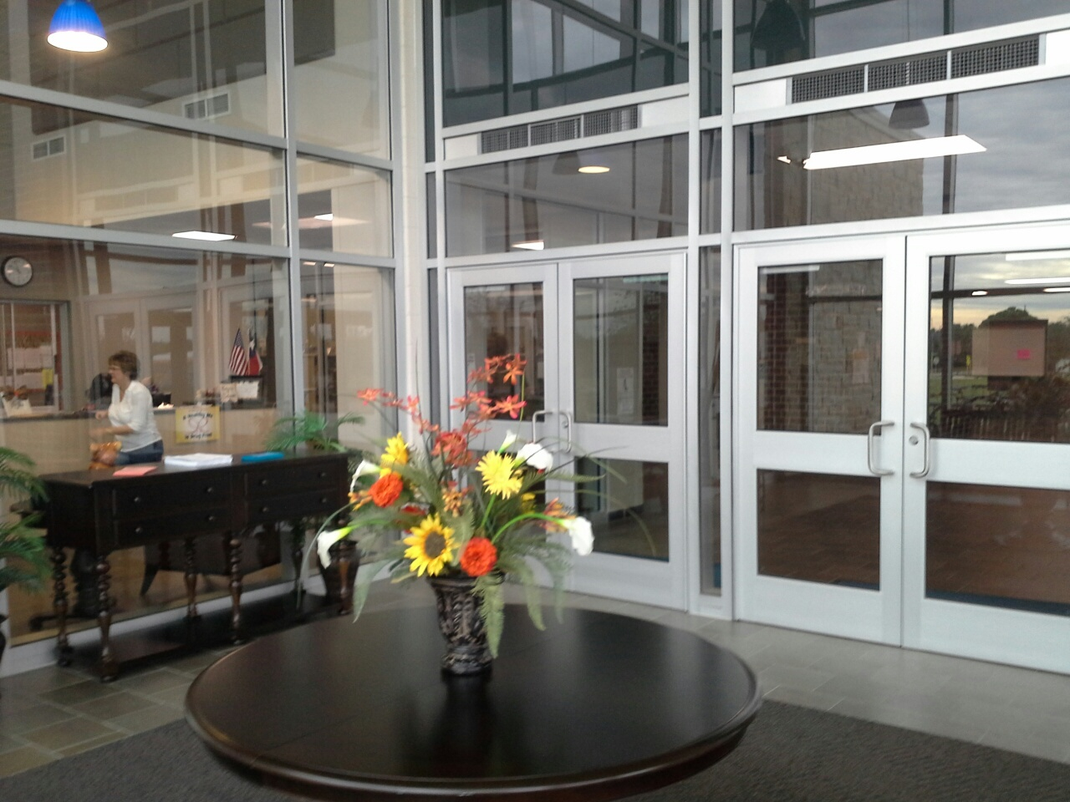

Slide 8
More School Ideas
Have Some Kind Of Shop In The School.
Have A Atm In The School.
Have A Spirit Store.
Have Robotics And Technology Classes.
Have A Auto Shop.
Have A Game Designer Program.

Slide 9
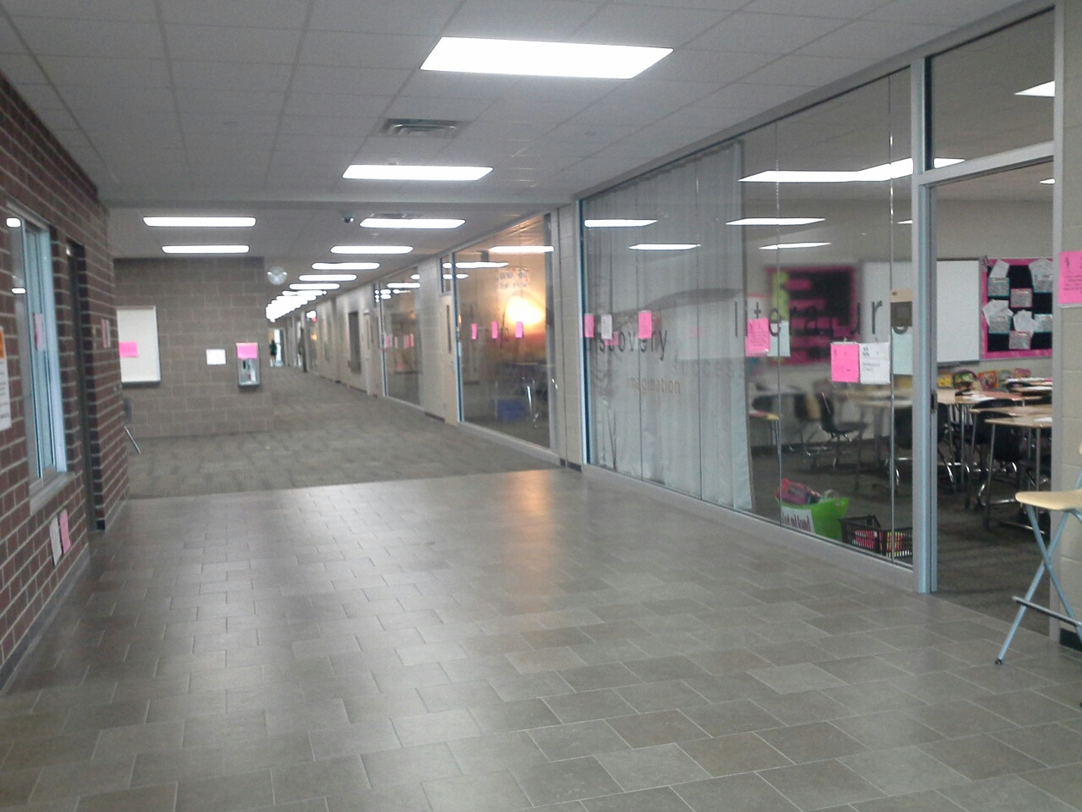

Slide 10
More School Ideas
Have A News Room For Morning News Or Announcements.
Have Academic Courses.
Have A Court Room.
Kid’s Being Able To Check Out Laptops.
Have 3-D Crime Scenes Or 3-D Something.

Slide 11
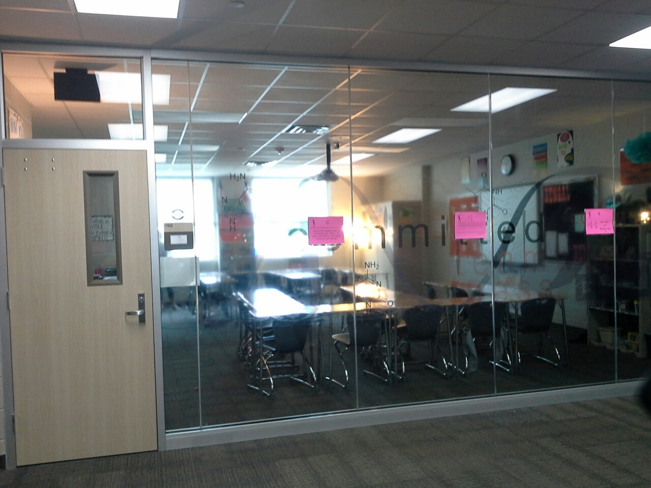

Slide 12
More School Ideas
Have A In School Daycare.
Have Crime Scene Investigations.
Have A Bigger Court Yard.
Have A Bigger Cafeteria.
When Building Gym’s And Locker Room’s Put Gym’s On The Top Floor Or The Second Floor And Locker’s On The First Floor.

Slide 13
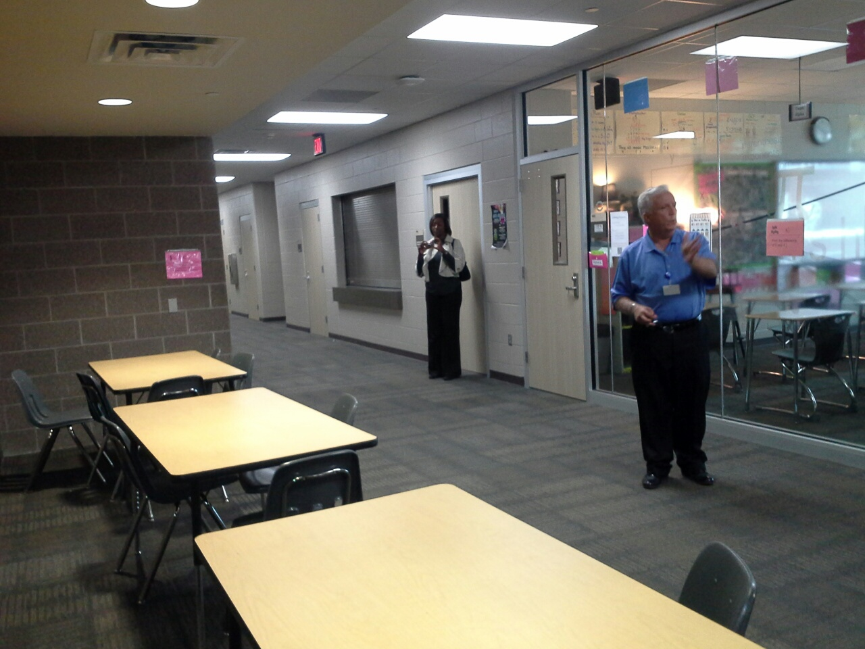

Slide 14
More School Idea’s
Put Window’s In Classroom’s Let The Classroom’s Be Open.
Stop Taking Points From Kids Just Because The Paper Is Late Or They Are Not Going To Do It At All.
Home Cook The Food That The Kid’s Eat In The Cafeteria.

Slide 15
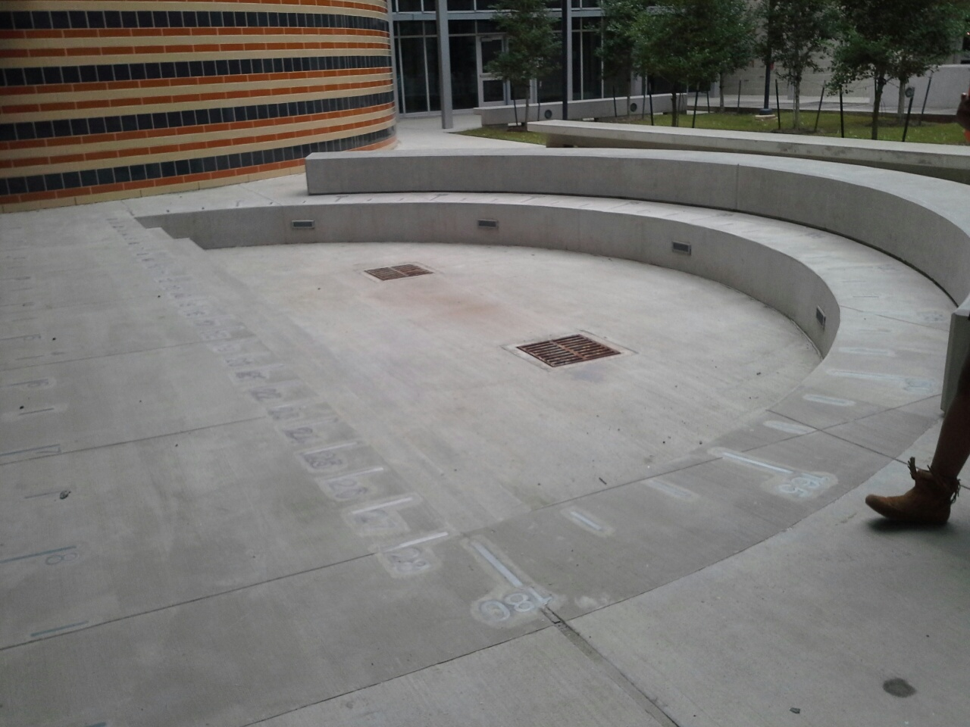

Slide 16
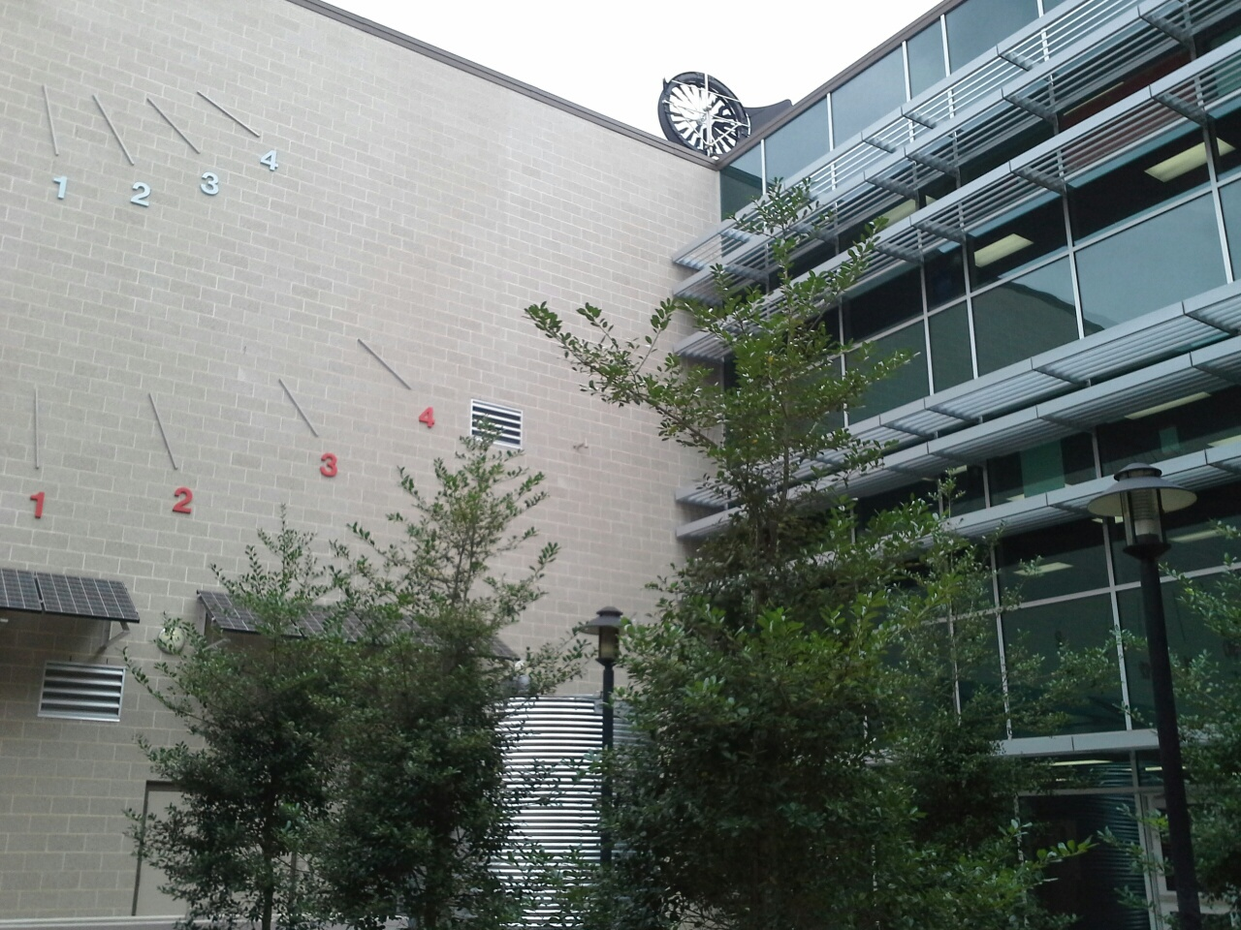

Slide 17
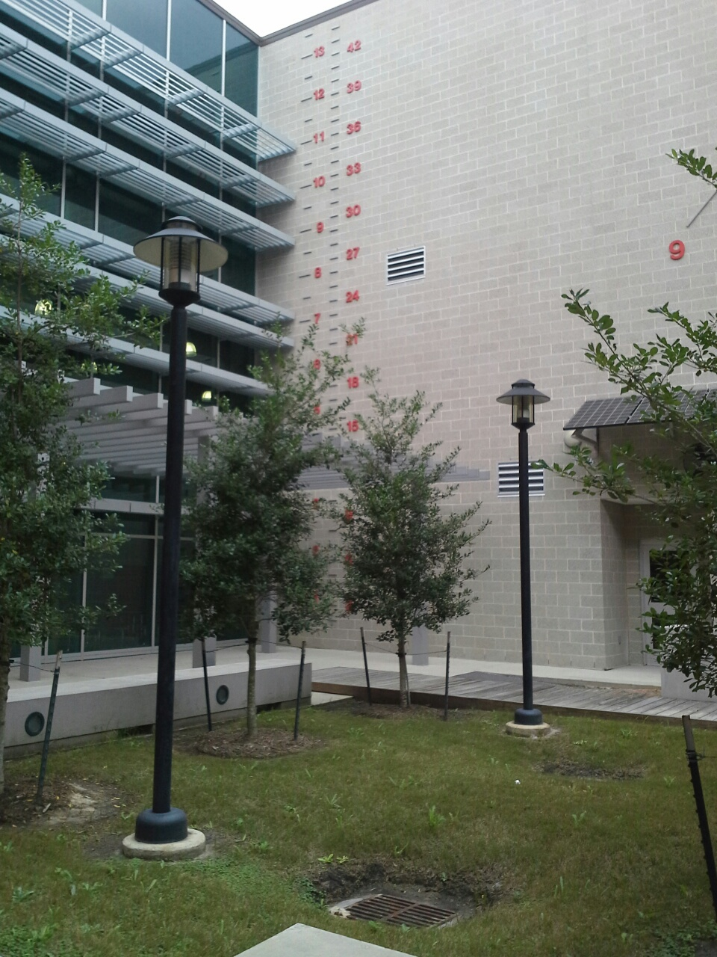

Slide 18
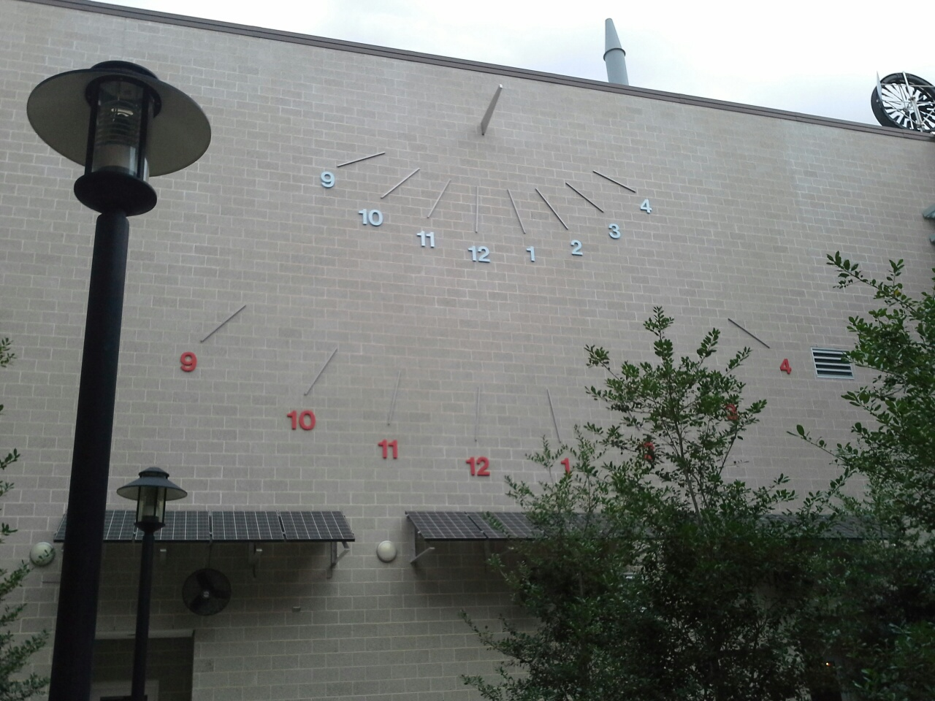

Slide 19
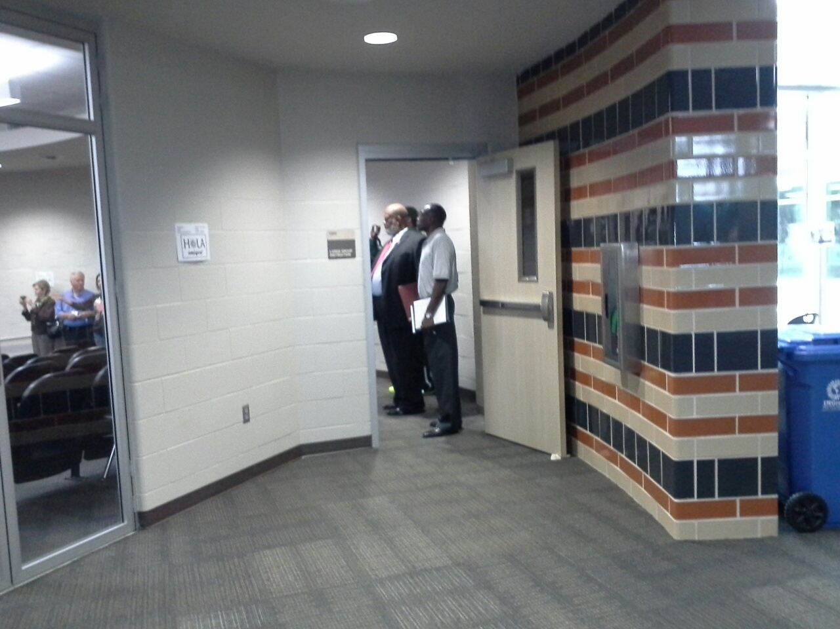

Slide 20
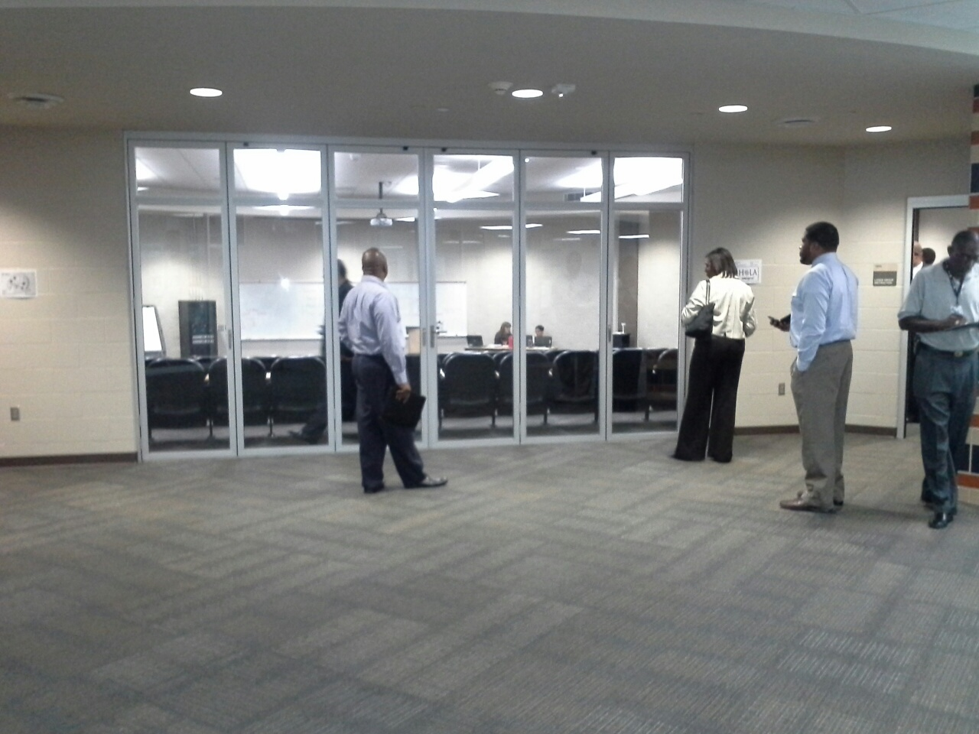

Slide 21
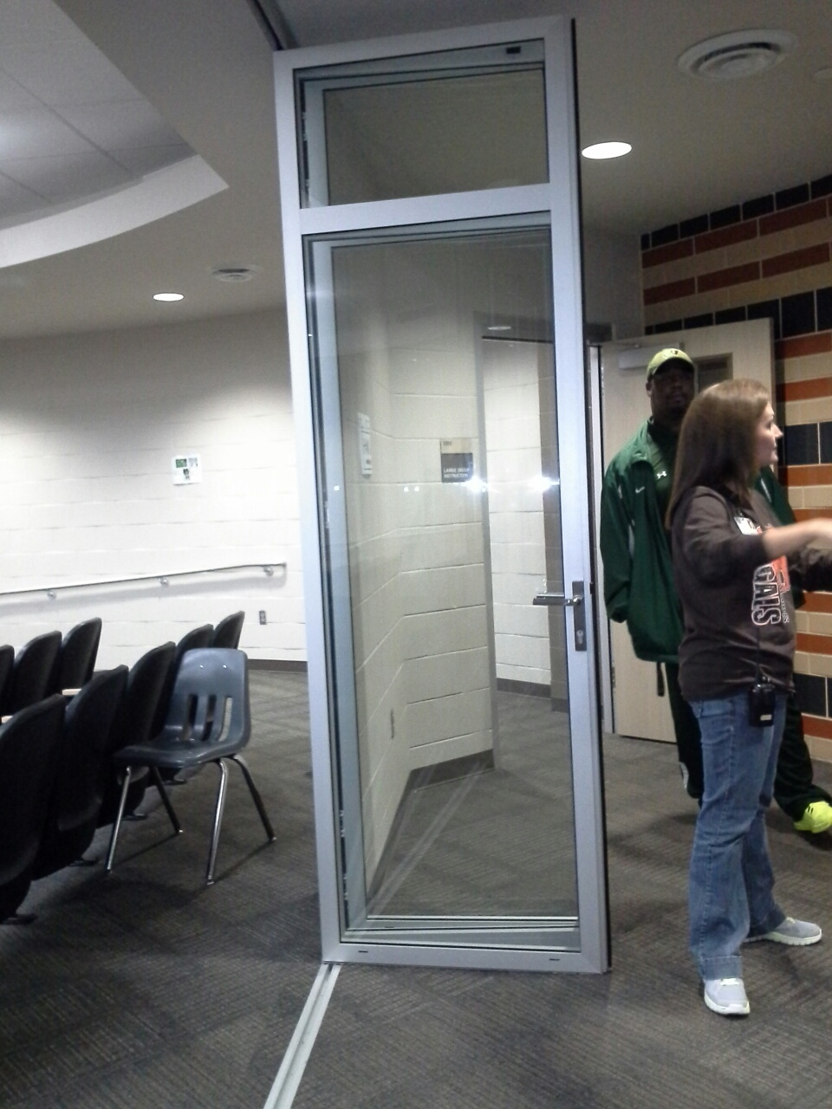

Slide 22
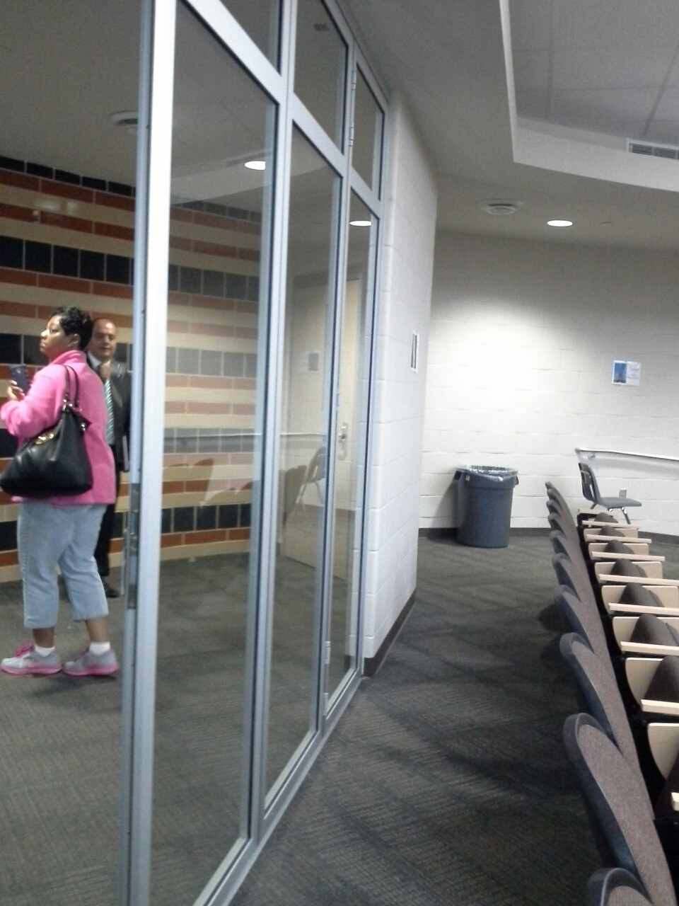

Slide 23
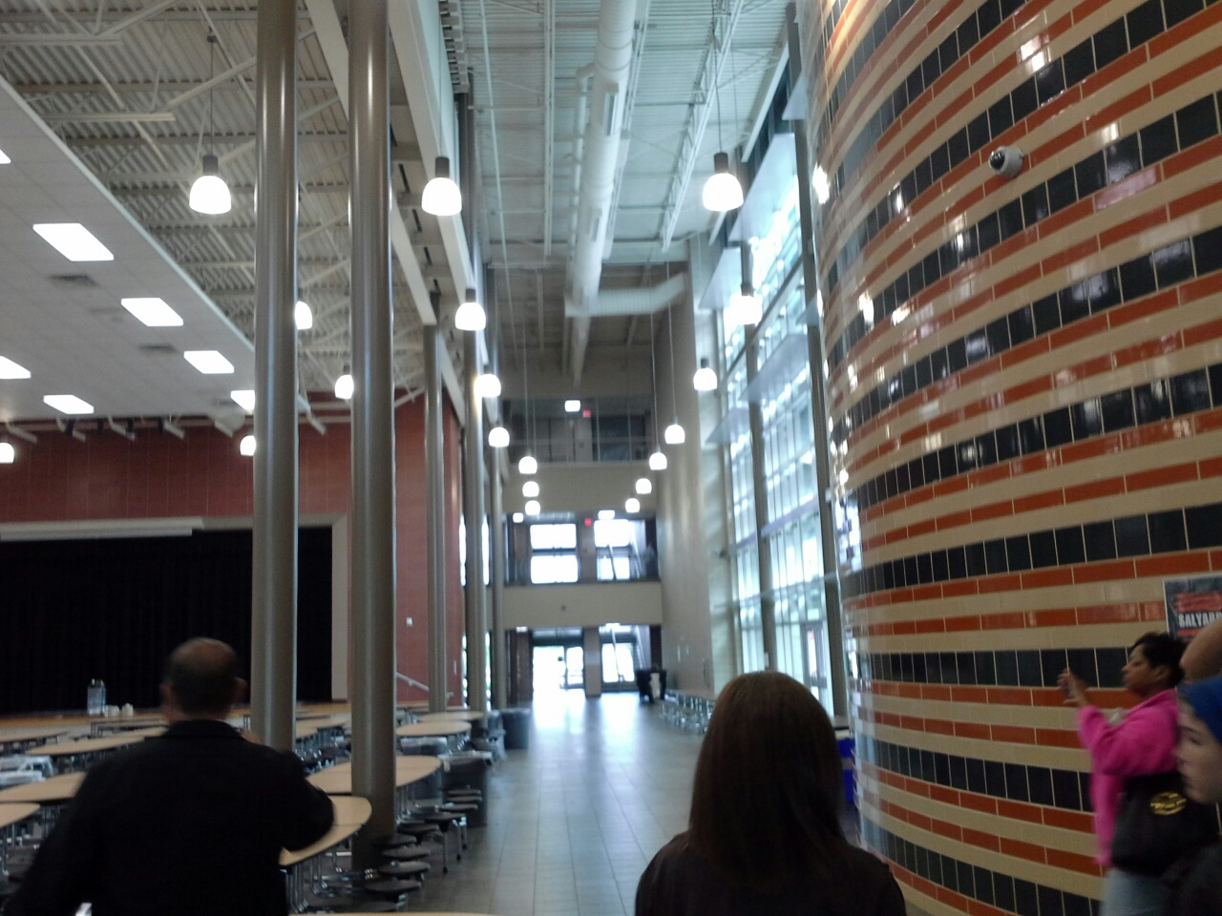

Slide 24
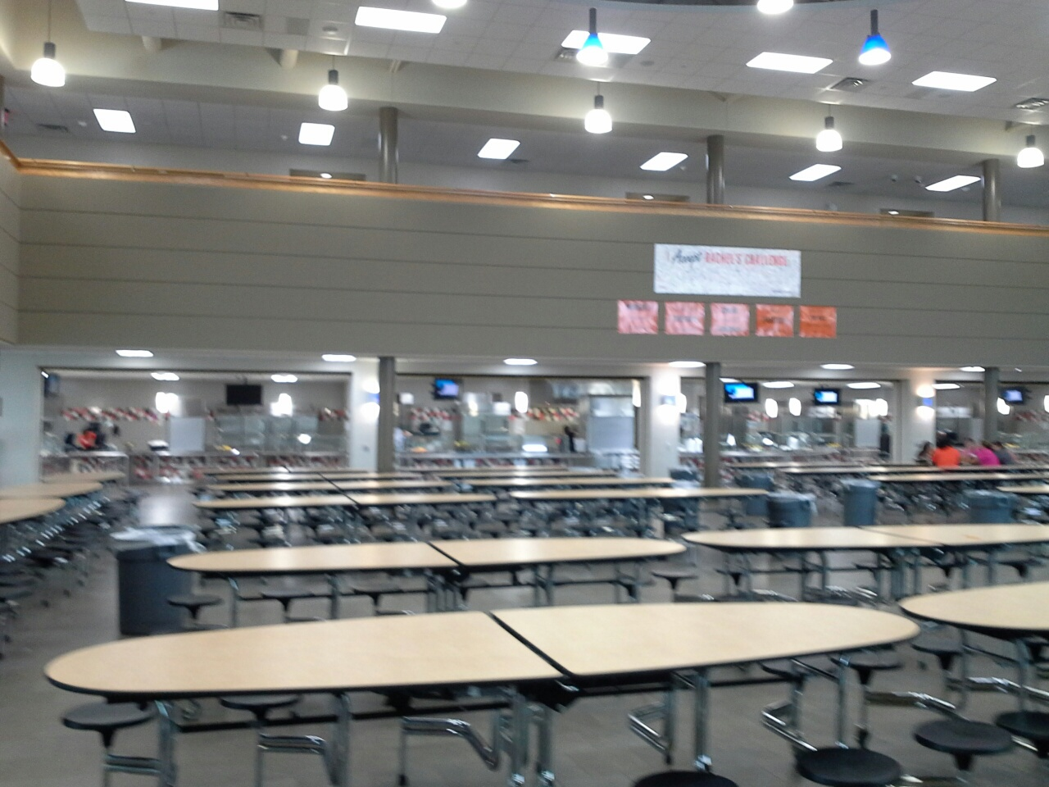

Slide 25
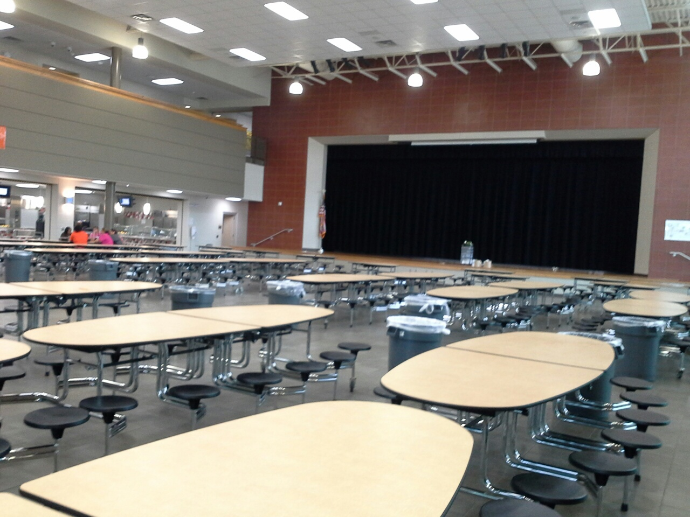

Slide 26
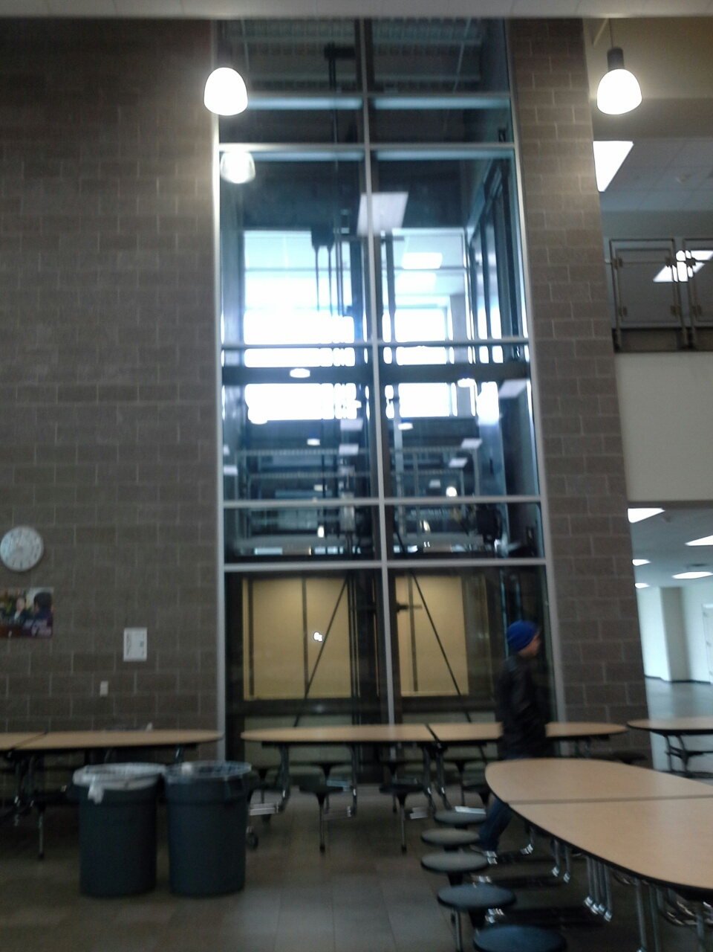

Slide 27
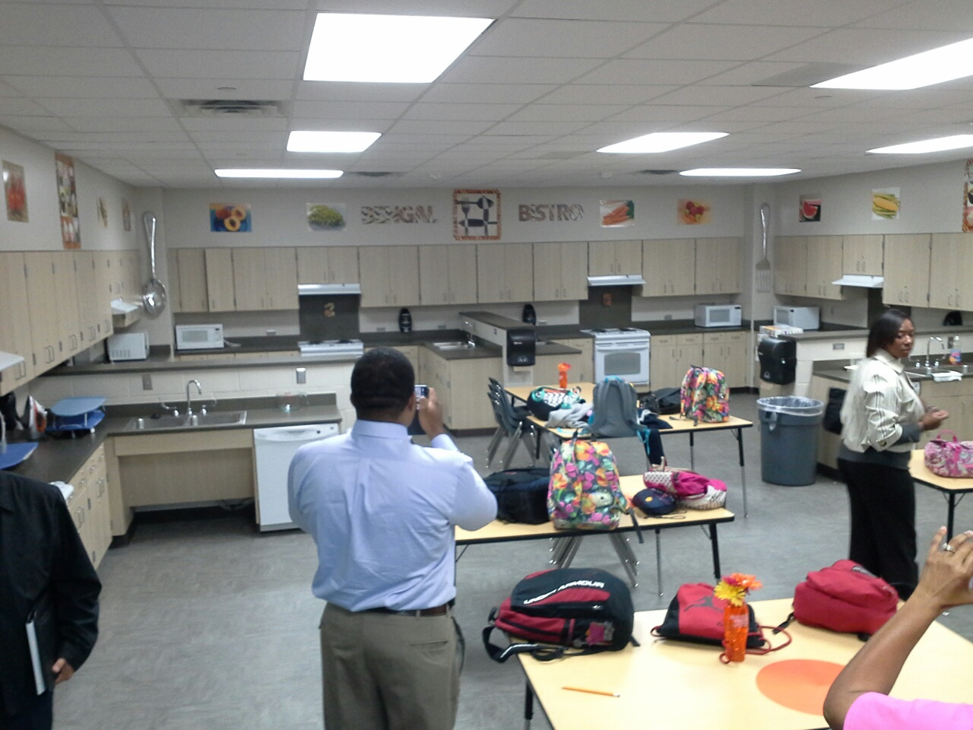

Slide 28
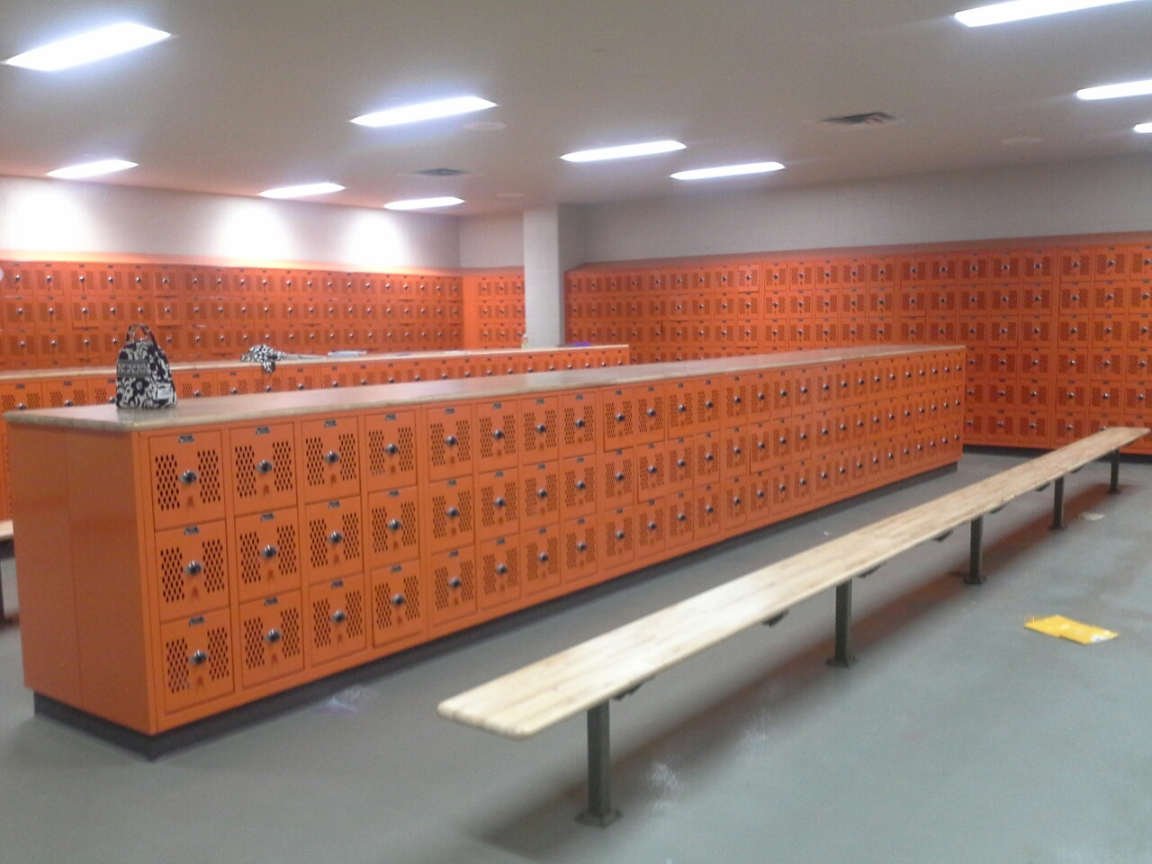

Slide 29
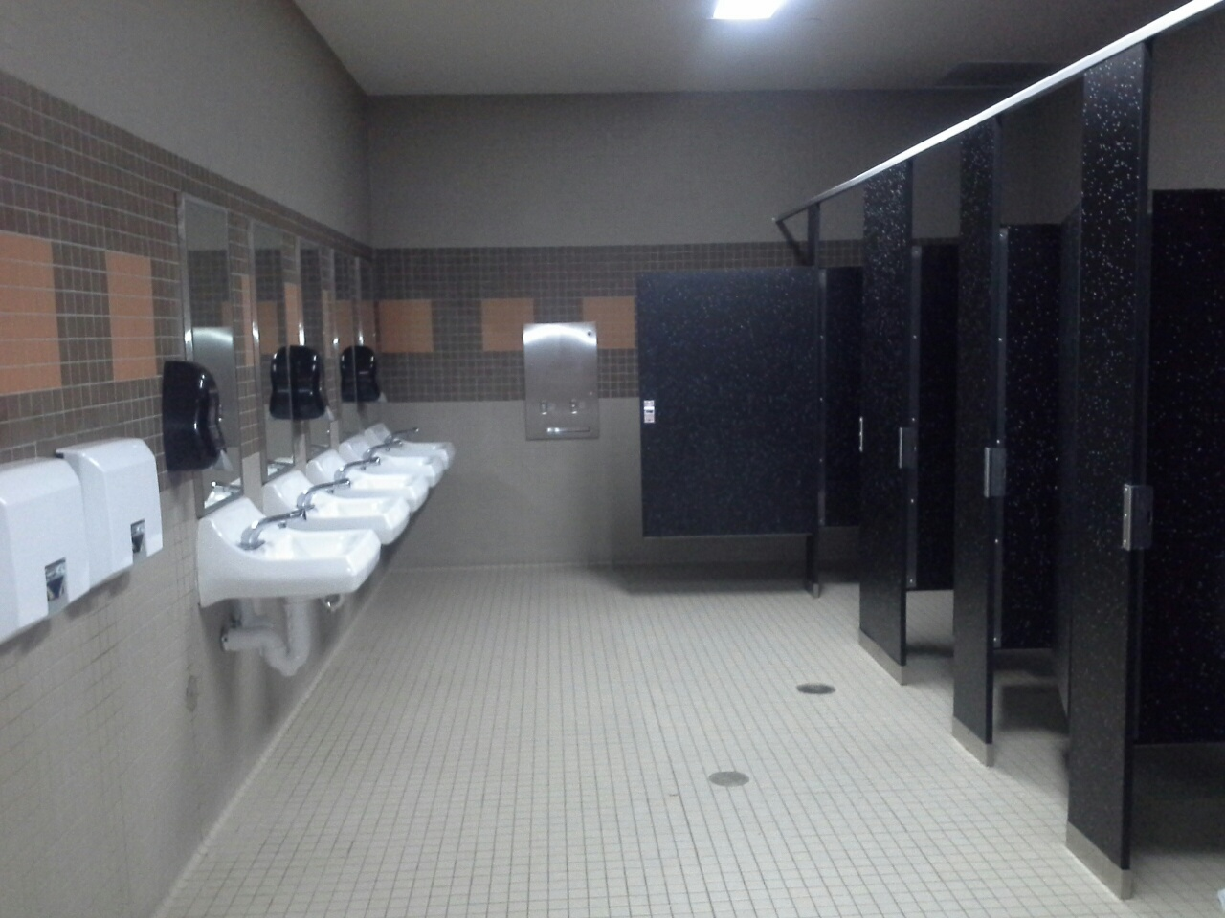

Slide 30
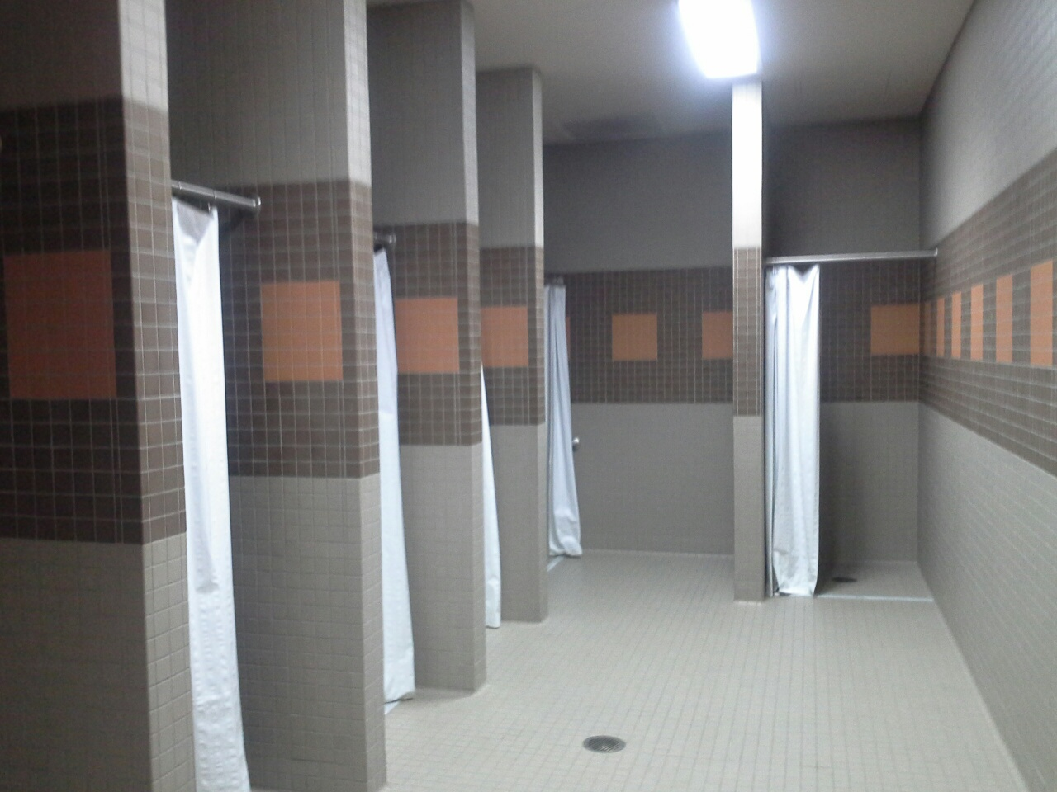

Slide 31
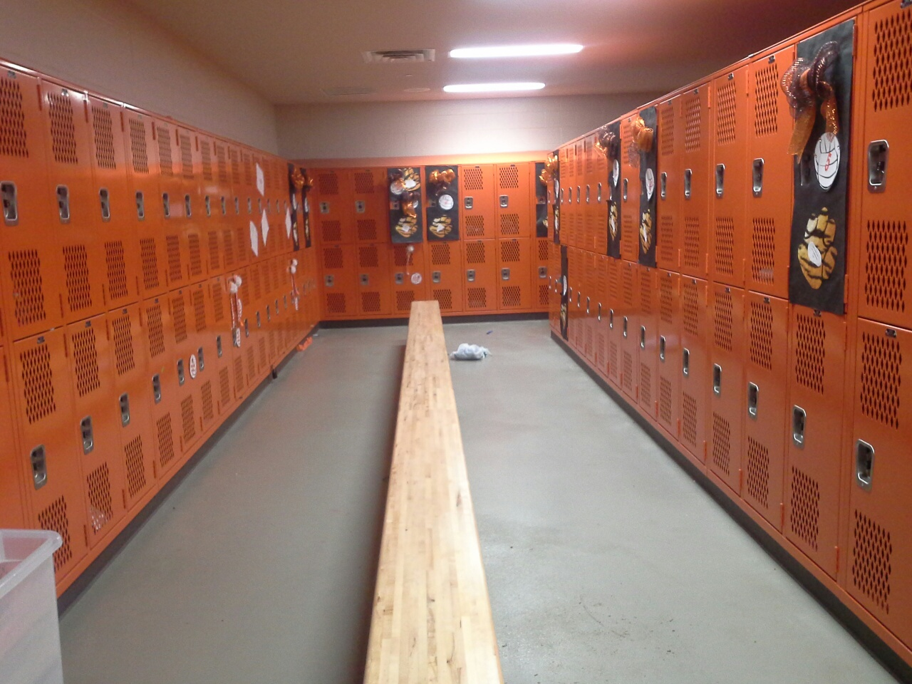

Slide 32
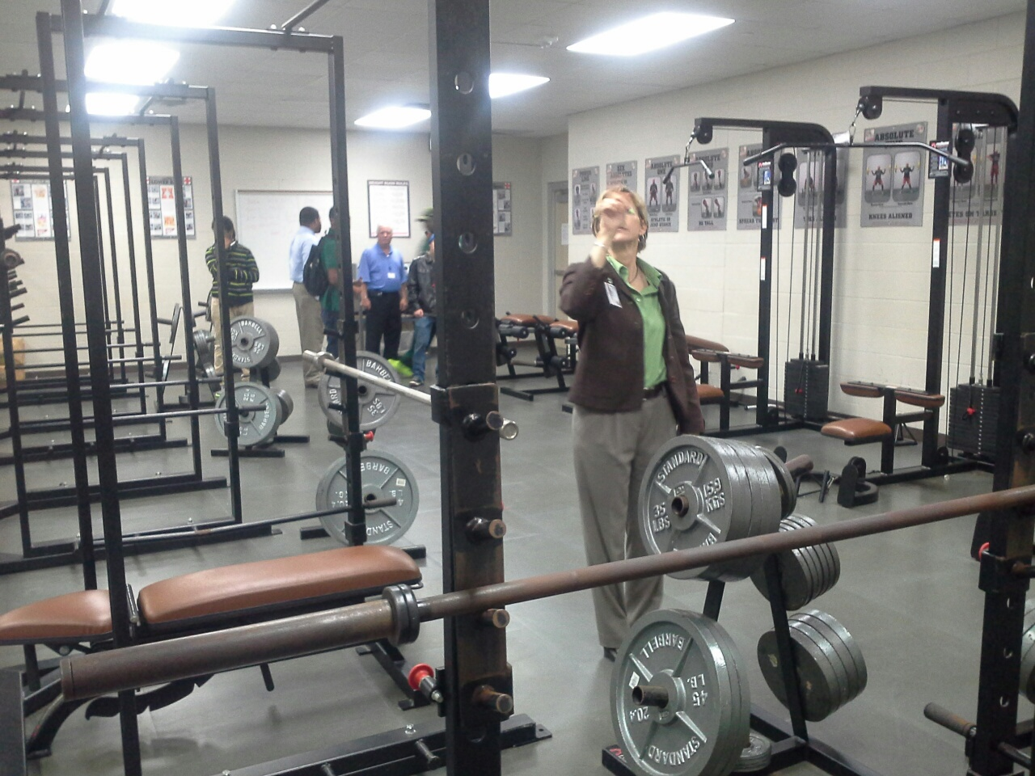

Slide 33
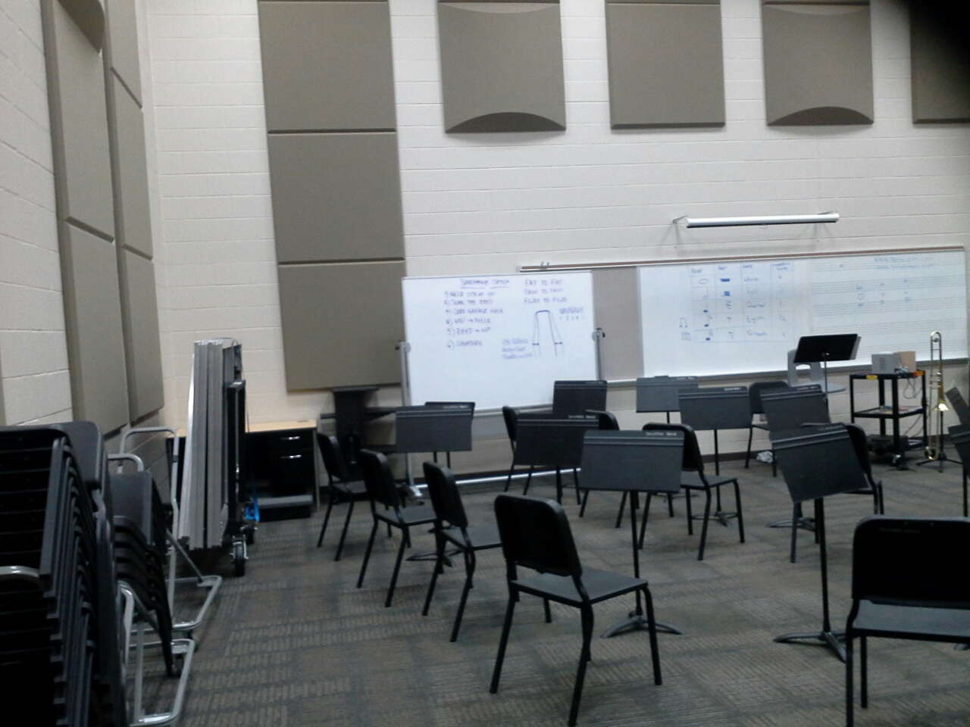

Slide 34
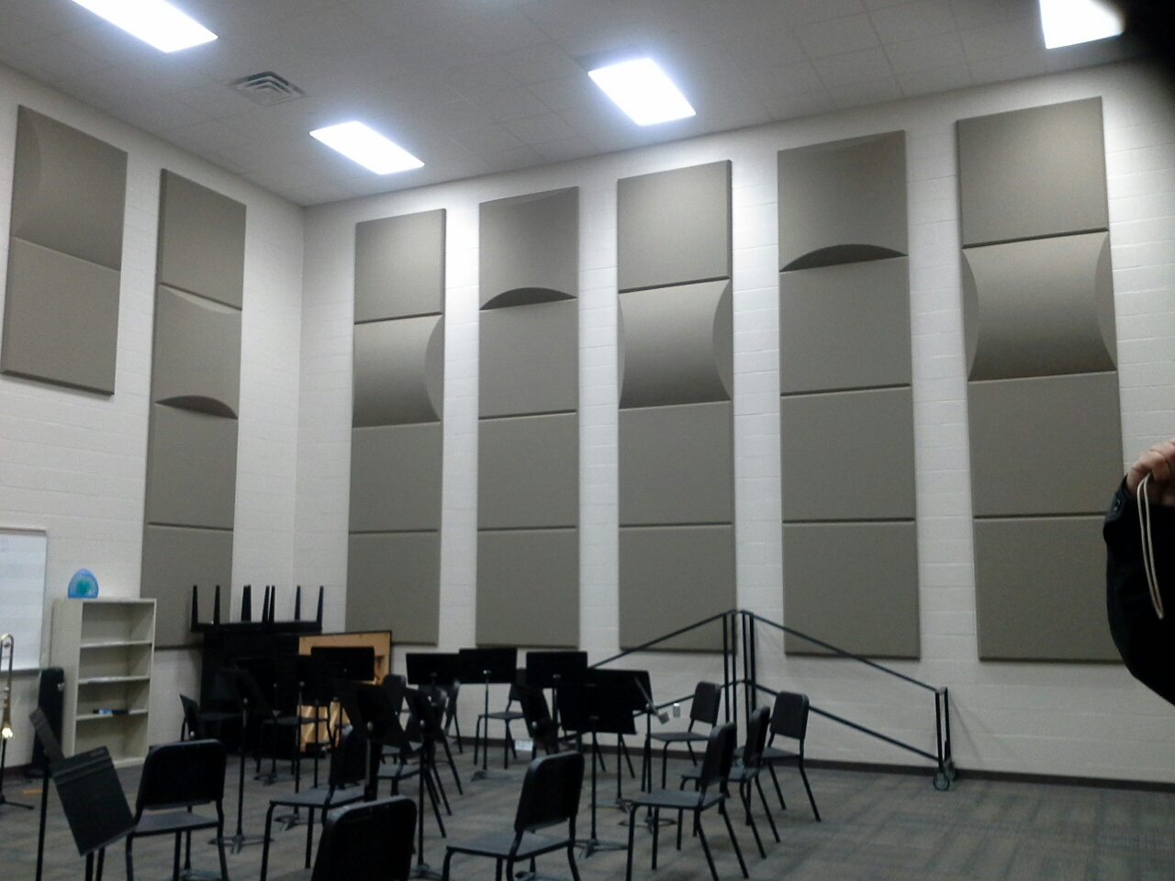

Slide 35
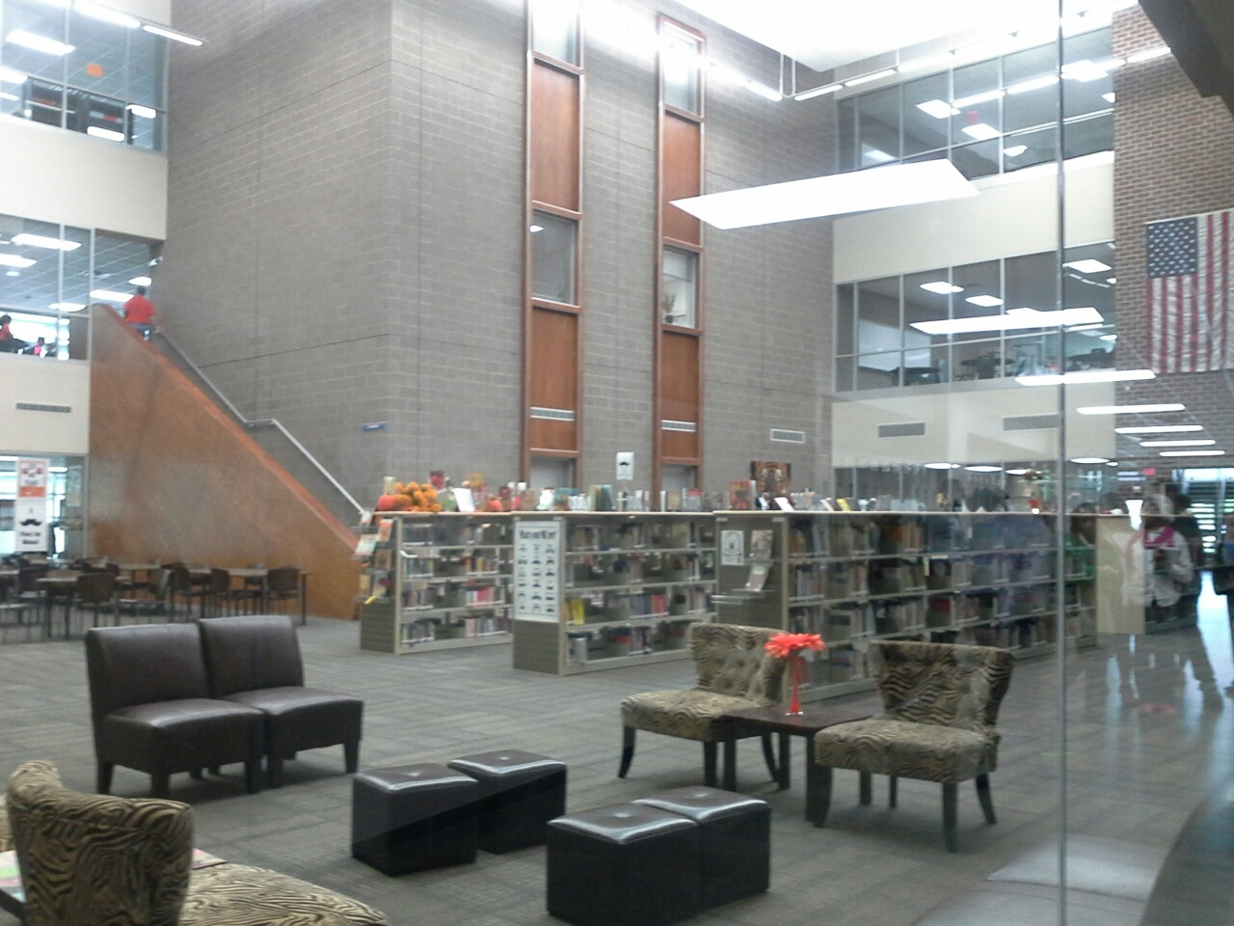

Slide 36
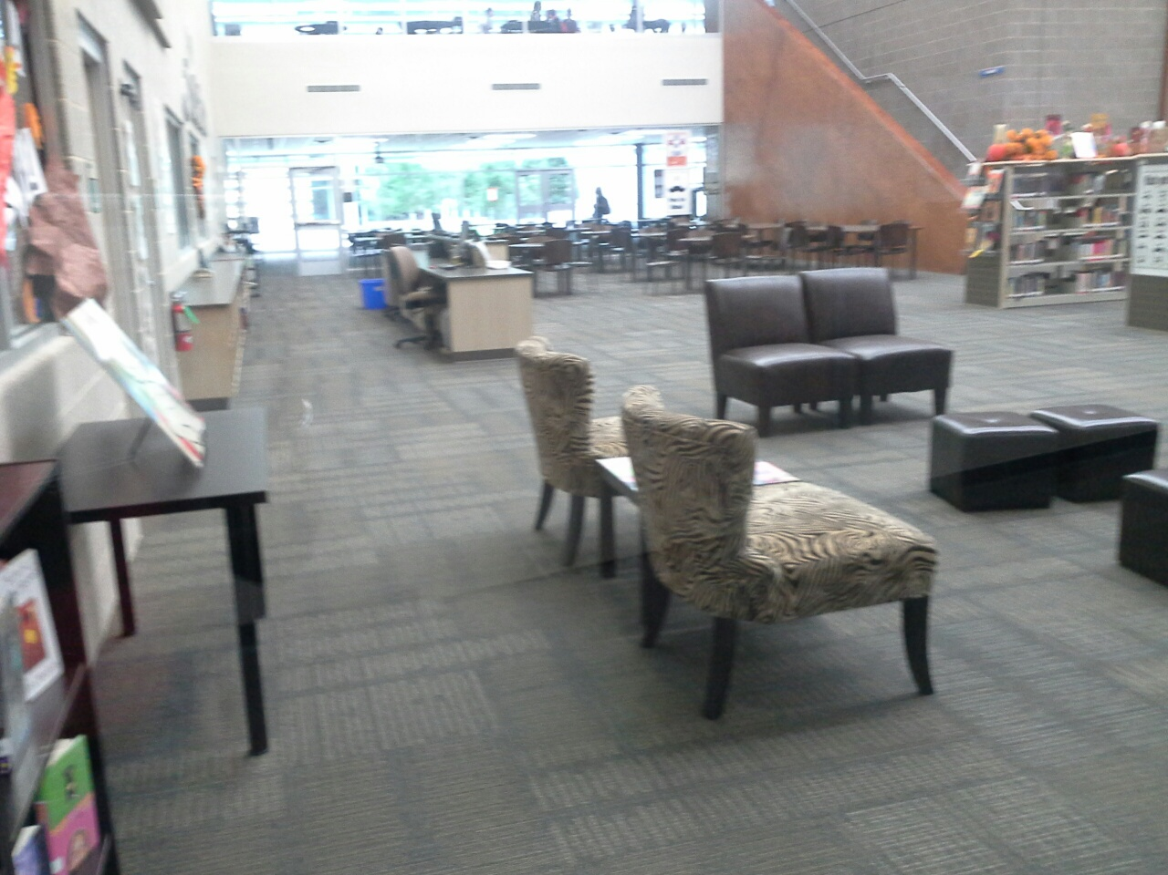

Slide 37
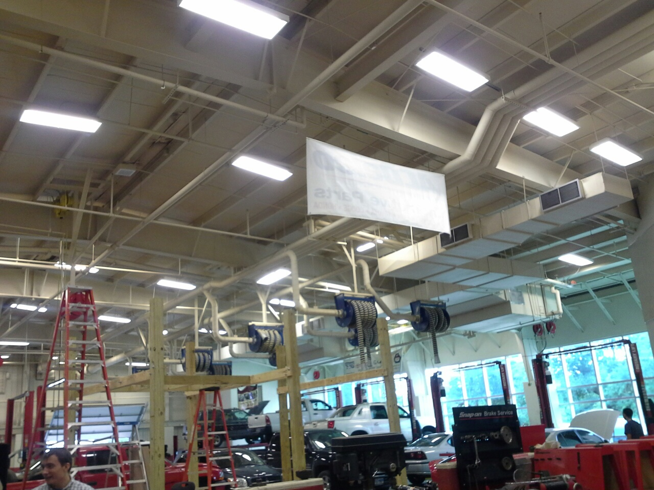

Slide 38
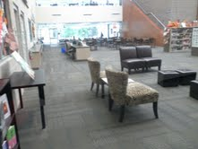

Slide 39
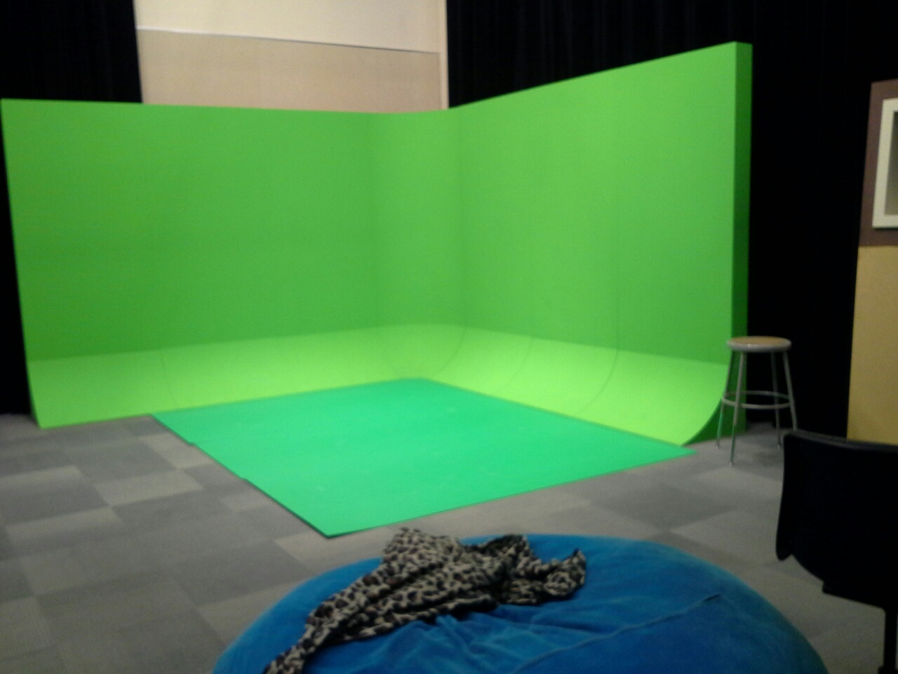

Slide 40
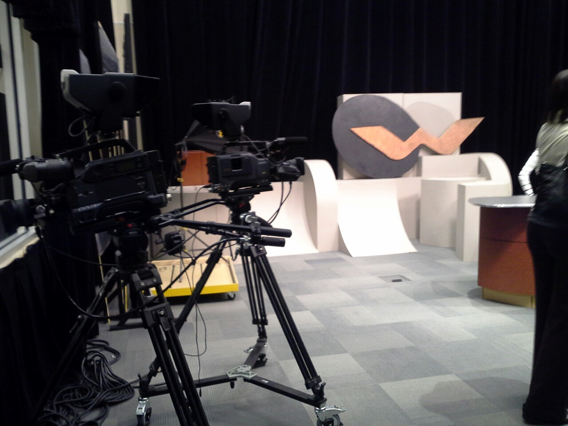

Slide 41
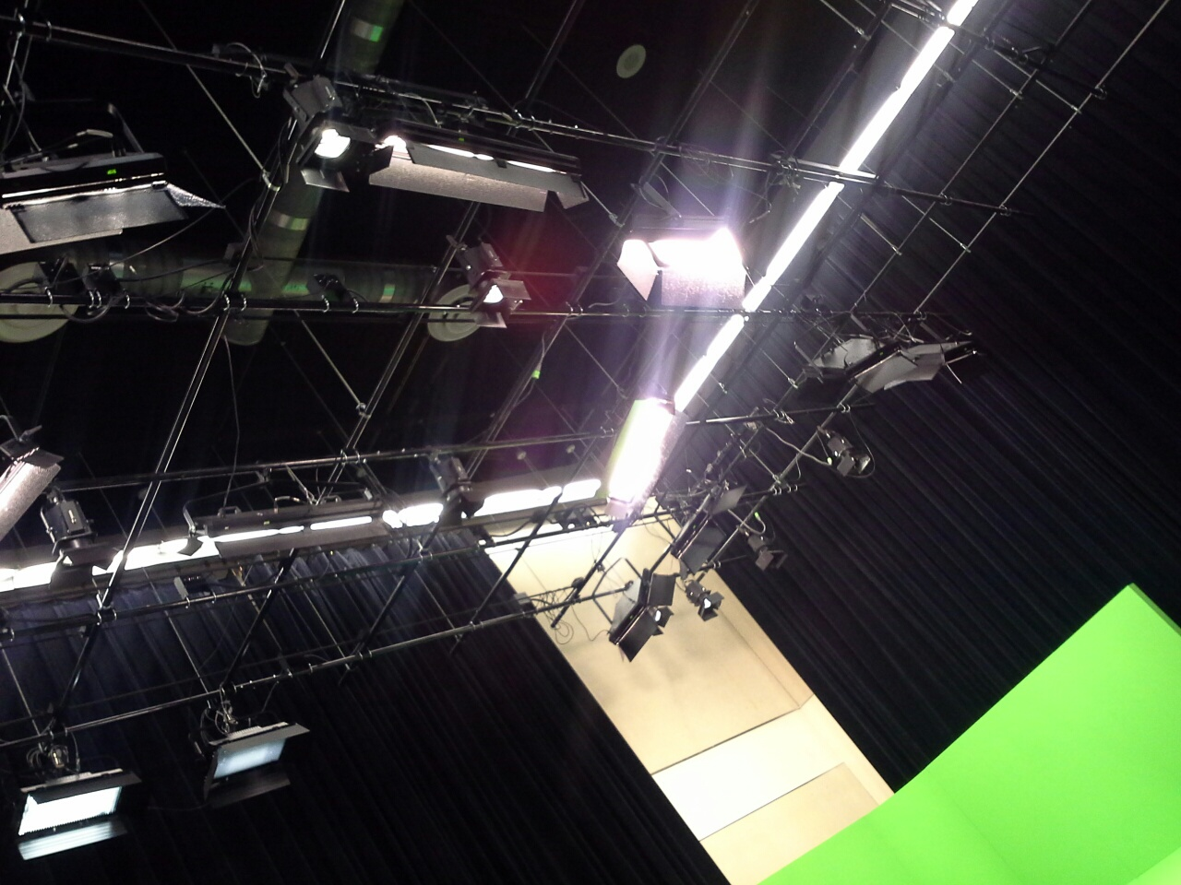

Slide 42
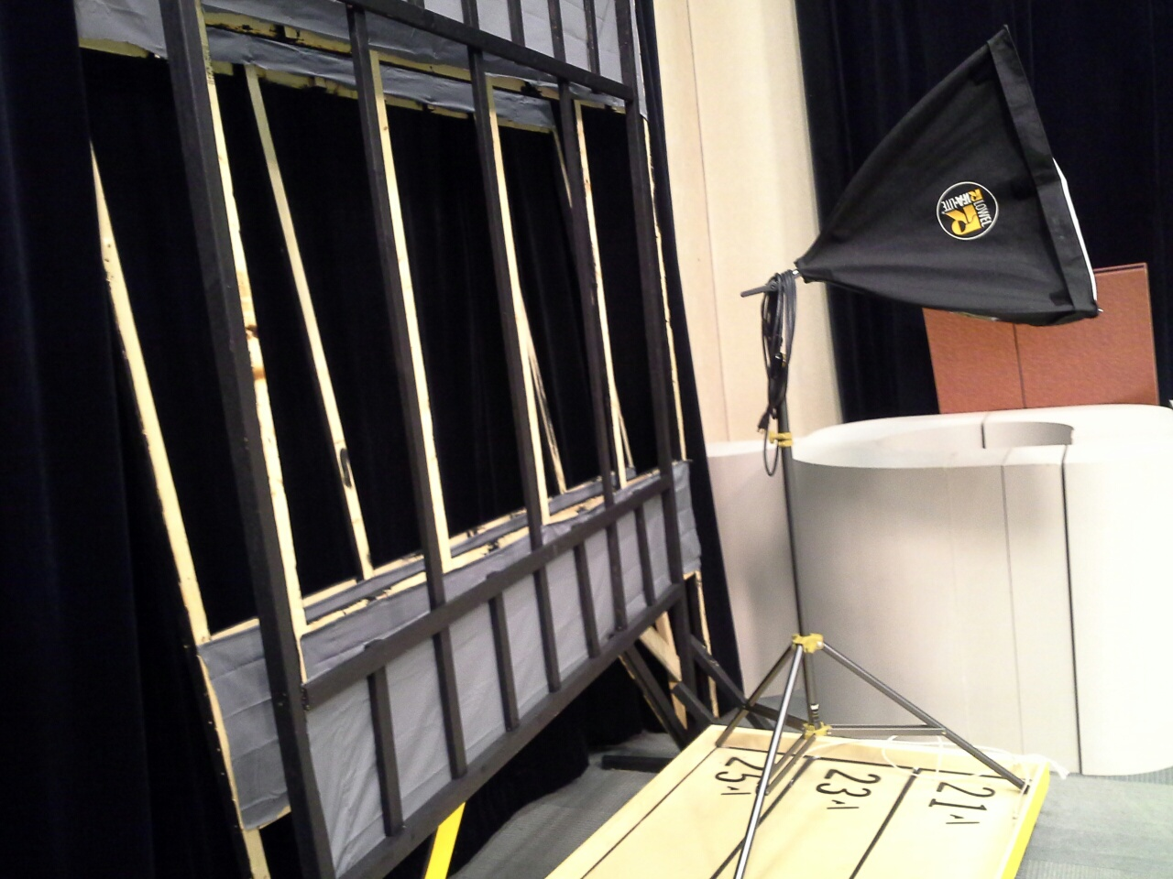

Slide 43
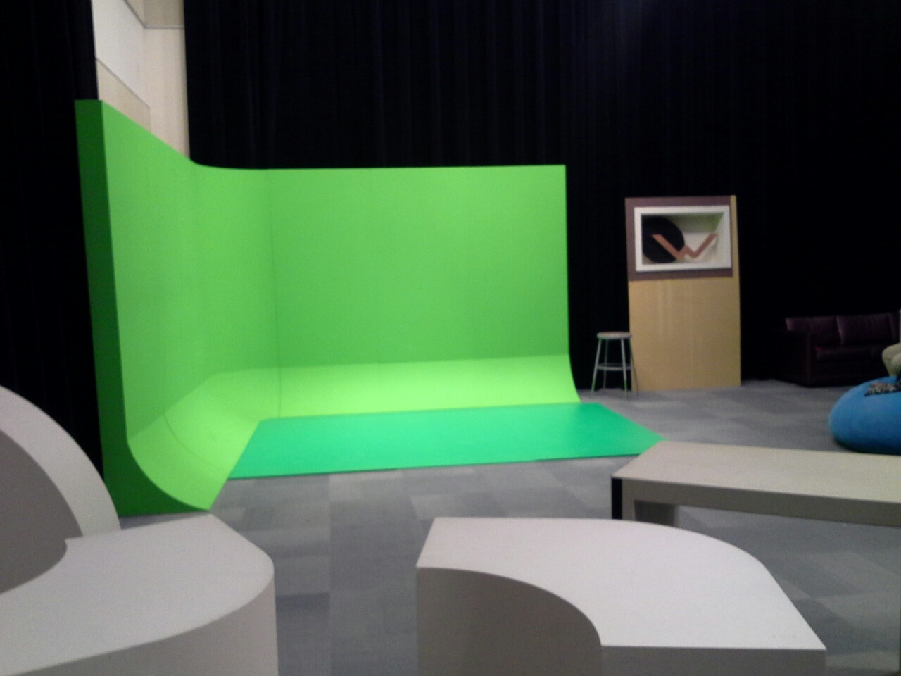

Slide 44
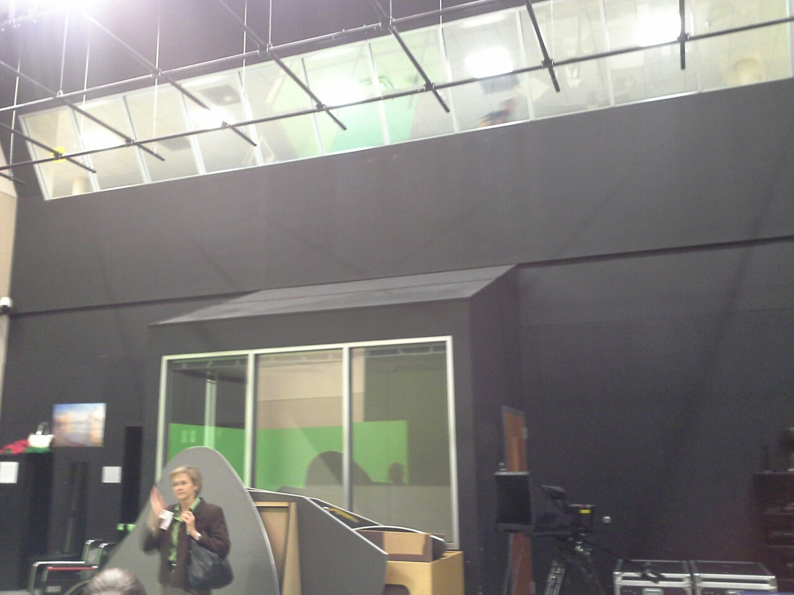

Slide 45
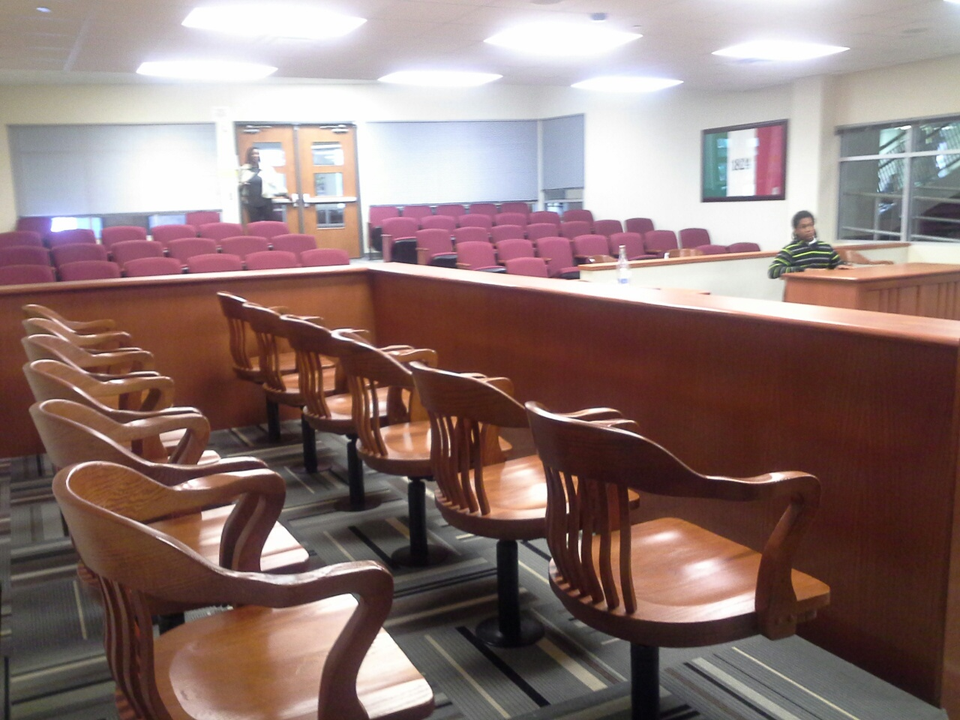

Slide 46
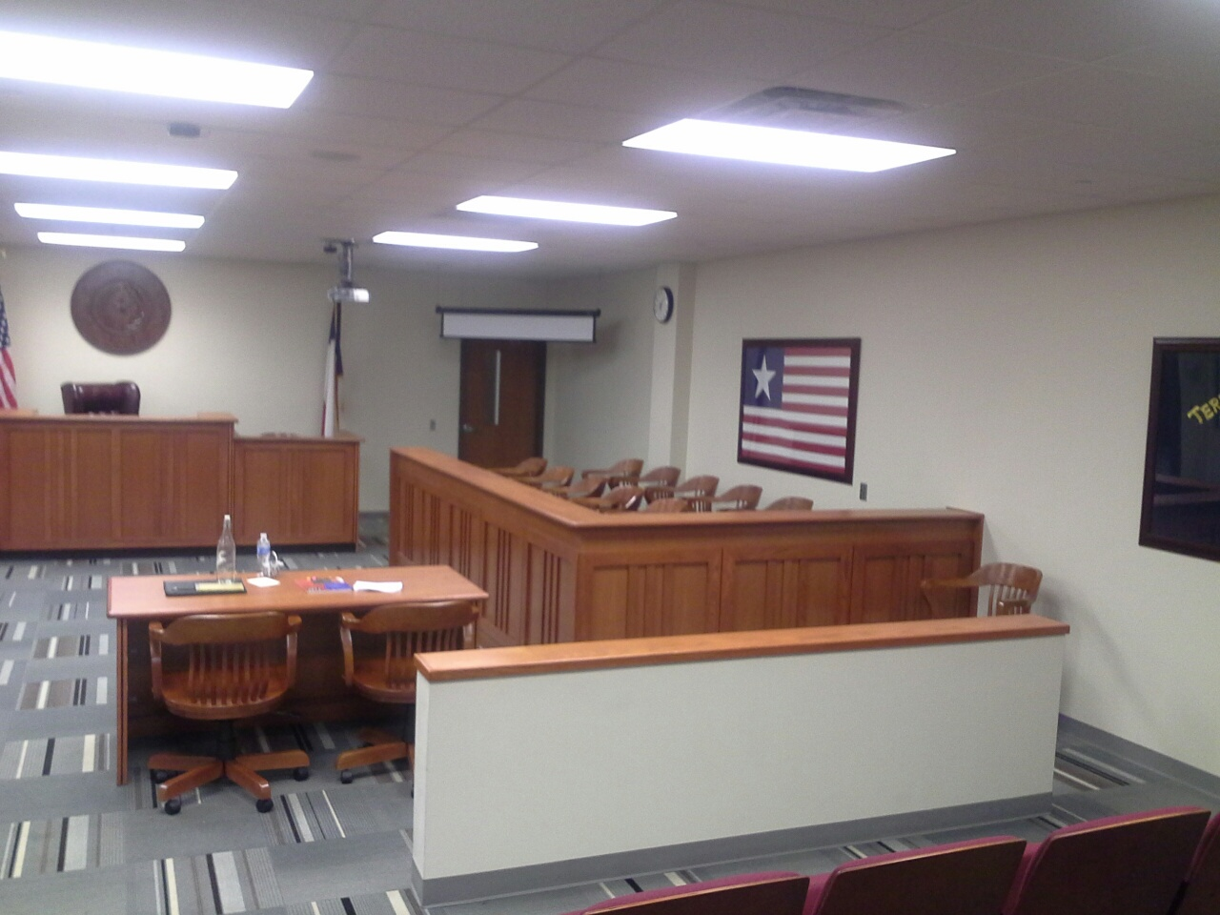

Slide 47
